Slide 1
Behaviour Driven Development

Slide 2
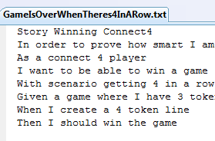
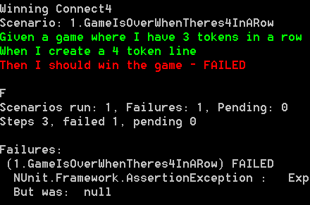
What if?
Specifications were written in visual studio?
Specifications could be executed?

Slide 3
What is BDD?
“Behaviour-driven development is about implementing an application by describing its behaviour from the perspective of its stakeholders”
-Dan North, 2006

Slide 4
What is BDD?
“BDD is a second-generation, outside-in, pull-based, multiple-stakeholder, multiple-scale, high-automation, agile methodology.
It describes a cycle of interactions with well-defined outputs, resulting in the delivery of working, tested software that matters.”
-Dan North, 2009

Slide 5
What is BDD?
Establishing the goals of different stakeholders required for a vision to be implemented
Drawing out features which will achieve those goals using feature injection
Involving stakeholders in the implementation process through outside-in software development
Using examples to describe the behaviour of the application, or of units of code
Automating those examples to provide quick feedback and regression testing
-Wikipedia

Slide 6
What is BDD?
Make your unit tests read like English instead of code
Returns, calls, invokes, raises, throws
Given, when, then!
Use these to talk to other people about requirements
Such tests are for providing examples of correct behaviour, rather than pinning down code correctness
-Me

Slide 7
How to do BDD
Take a feature
“You can win a game of Connect4”
Notes:
Who knows what Connect 4 is?

Slide 8
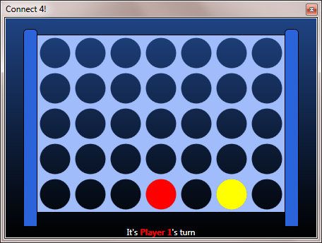
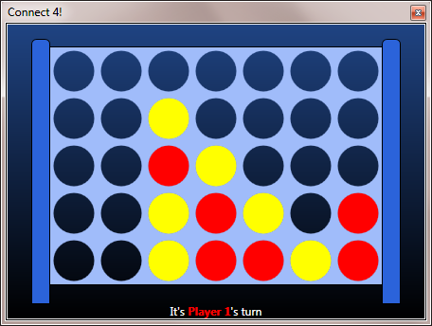
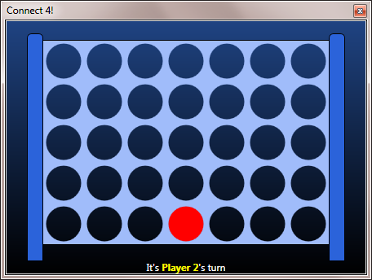
How to play Connect4

Slide 9
How to do BDD
Take a feature
“You can win a game of Connect4”
Tease out the business requirement (story) from the technical aspects (scenarios)
Story: Players want to feel like they are better than other people
Scenario: When there’s 4 of a player’s tokens in a horizontal row, then that player wins
Scenario: When there’s 4 of a player’s tokens in a diagonal row, then that player wins
Work these into the BDD Grammar

Slide 10
The BDD Grammar
Story is <Story Name>
In order to <Benefit>
As a <Role>
I want <Feature>
With Scenario <Scenario Name>
Given <Condition>
When <Operation>
Then <Outcome>
Repeat .
Notes:
Arrange Act Assert

Slide 11
Connect 4 “in BDD”
Story is Winning Connect4
in order to prove how smart I am
as a connect 4 player
I want to be able to win a game
with scenario getting 4 in a row
given a game where I have 3 tokens in a row
when I create a 4 token line
then I should win the game
Notes:
Antipatterns
Remember the when step
No need to overspecify (given a game .. AND there is a spare slot when I move in that slot)
Getting technical “The current player should be set as the winning player, and the WinningPlayer propertyChangedNotification should fire

Slide 12
BDD Workflow
Elicit requirements
Express this in an executable system
Develop system (passed?)
Run tests (pending?)
Finish tests (failed?)
Determine the right features
Notes:
Features fulfil requirements

Slide 13
BDD Framework evolution

Slide 14
BDD in Java
AgileDox
Turns jUnit test names into sentences
Jbehave
Started out as classes for Givens, Methods for When and Then
Now it’s an external DSL
Write stories in plaintext
Pending
(Later) developers write Step methods to match the plaintext
Failing -> Passing

Slide 15
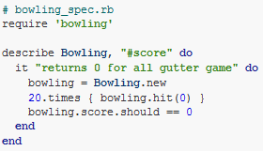
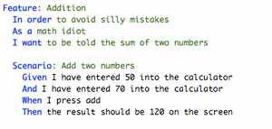
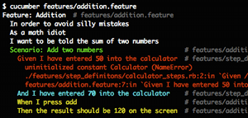

BDD in Ruby
RSpec (nee RBehave)
Cucumber
Notes:
Ruby is awesome for internal DSLs?

Slide 16
BDD Frameworks for .NET

Slide 17
.NET Frameworks (wikipedia)
Aubergine
Cucumber
Machine.Specifications
Nbehave
Nspec
Nspecify
Specflow
Specter (boo)
SpecUnit
StoryQ

Slide 18
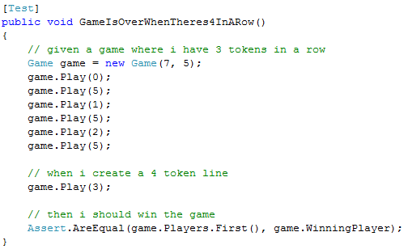
No BDD Framework

Slide 19
NBehave
Started out as an internal DSL
Now it’s external
Plain text input
Method names are matched to your text
Lots of contributors
Has its own console runner
Demo

Slide 20

Specflow
External DSL
High level of VS integration
Leverages NUnit
Plain text is converted to NUnit tests via custom tool
Demo

Slide 21

StoryQ
Internal DSL
With a plain text to code converter
Focuses on formatting
Very simple to use (reference one DLL)
Tries to keep you on the rails
Embeds in any unit test system
Demo

Slide 22
Why BDD?

Slide 23


Advantages of BDD
Specs
Code
Test Suite
When the test suite bridges the gap between specifications & code

Slide 24
Advantages of BDD
Non technical people
Developers
Test Suite
When the test suite bridges the gap between stakeholders and developers

Slide 25
Advantages of BDD
Other Developers
Developers
Test Suite
When the test suite bridges the gap between developers and other developers
Notes:
Fitnesse is the classes ATDD framework
Too much effort?

Slide 26
Why BDD?
Developer-Stakeholder Interaction
BA’s, Testers, PMs, Business etc
Focus on delivering business value
“Examples” are in business domain language
Documentation and validation of both code and requirements
TDD + Executable Specifications
Less effort than TDD
Higher level?
Notes:
Like TDD
Tests provide examples of code use
Tests can verify that code does what it should
Like Executable Specifications (Fitnesse)
Developer is forced to think about business cases
TDD can cause overspecification – ping pong story

Slide 27
Further Reading
http://dannorth.net/introducing-bdd
http://lizkeogh.com/2007/06/13/bdd-tdd-done-well/
http://en.wikipedia.org/wiki/Behavior_driven_development
http://skillsmatter.com/event/agile-testing/agile-specifications-bdd-and-testing-exchange

Slide 28
Questions

